Slide 1


NITIKANEXUS
Your AI chatbot for all things Nitika!
https://nitkanexus.vercel.app
NAME OF PROJECT:
PRESENTED BY:
PRESENTED TO:
AI Chatbot
Nitika Borkar
SAP

Slide 2
Project Overview
NitikaNexus is a personalized, AI-powered chatbot named after its creator, Nitika. It is designed to engage users with intelligent, responsive conversations, providing helpful information, answering queries, and offering support in a manner that feels uniquely tailored to the user.
The chatbot leverages advanced natural language processing (NLP) techniques to understand user intent, making it versatile in handling a wide range of topics.
The project showcases integration between a React frontend and a python backend, hosted on Vercel and Heroku, respectively.

Slide 3
Tech Stack
Frontend:
React: For building a dynamic and responsive user interface.
CSS: Custom styling to ensure a clean, modern look and feel.
Vercel: For seamless deployment and hosting of the frontend application.
Backend:
Python & Flask: A lightweight framework for serving the backend API, handling requests, and managing the chatbot's core logic.
OpenAI API: Utilized for accessing advanced GPT models to power the chatbot's conversational capabilities.
LangChain: Integrated to manage the chaining of LLM calls and context management, enhancing the chatbot’s ability to handle multi-turn conversations.
Retrieval-Augmented Generation (RAG): Implemented to combine real-time data retrieval with LLM outputs, enabling more accurate and context-rich responses.
Heroku: For hosting the backend, ensuring reliable performance and easy scalability.
Data Management:
Vector Stores: Used for storing and retrieving embeddings that represent the chatbot’s knowledge base, enabling efficient and accurate information retrieval during conversations.

Slide 4
User Interface

Slide 5
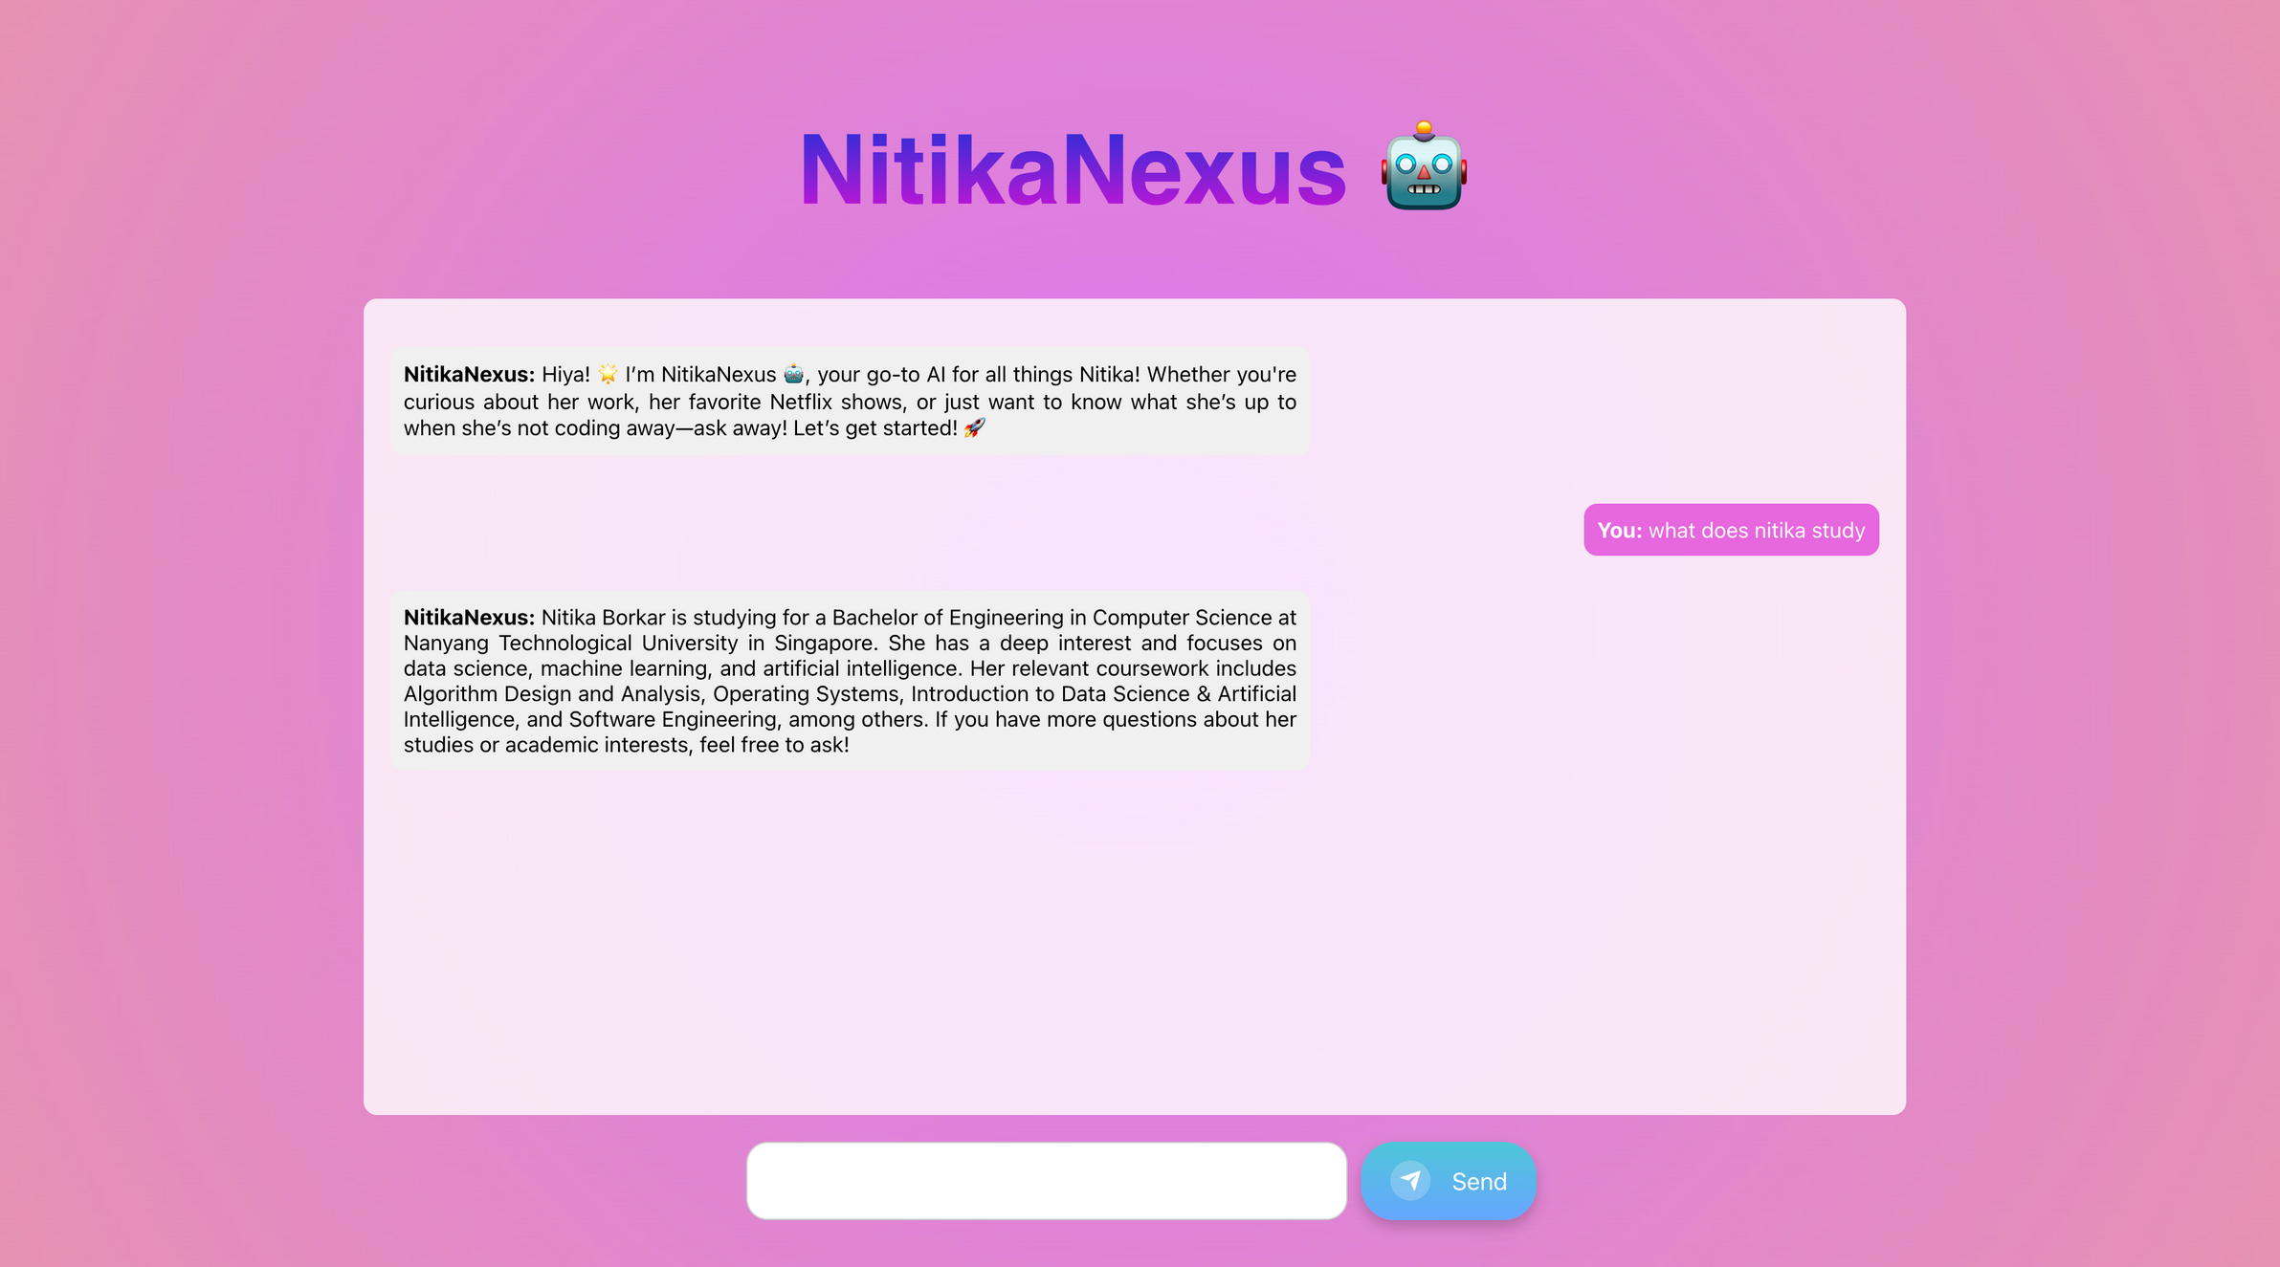

Slide 6
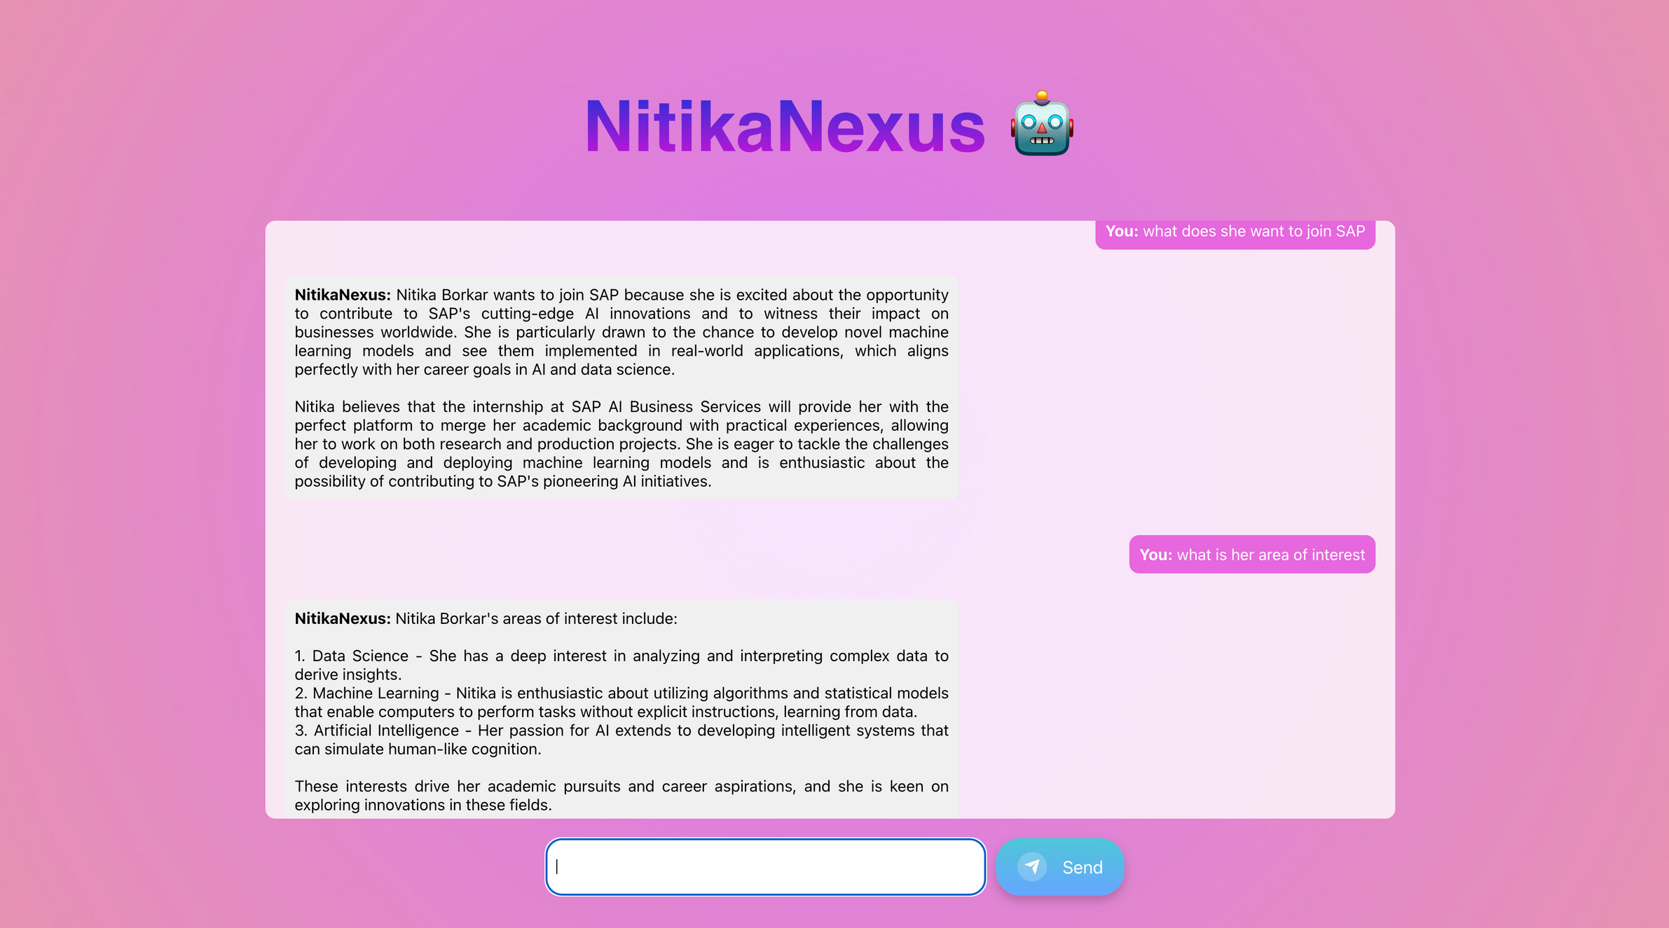

Slide 7
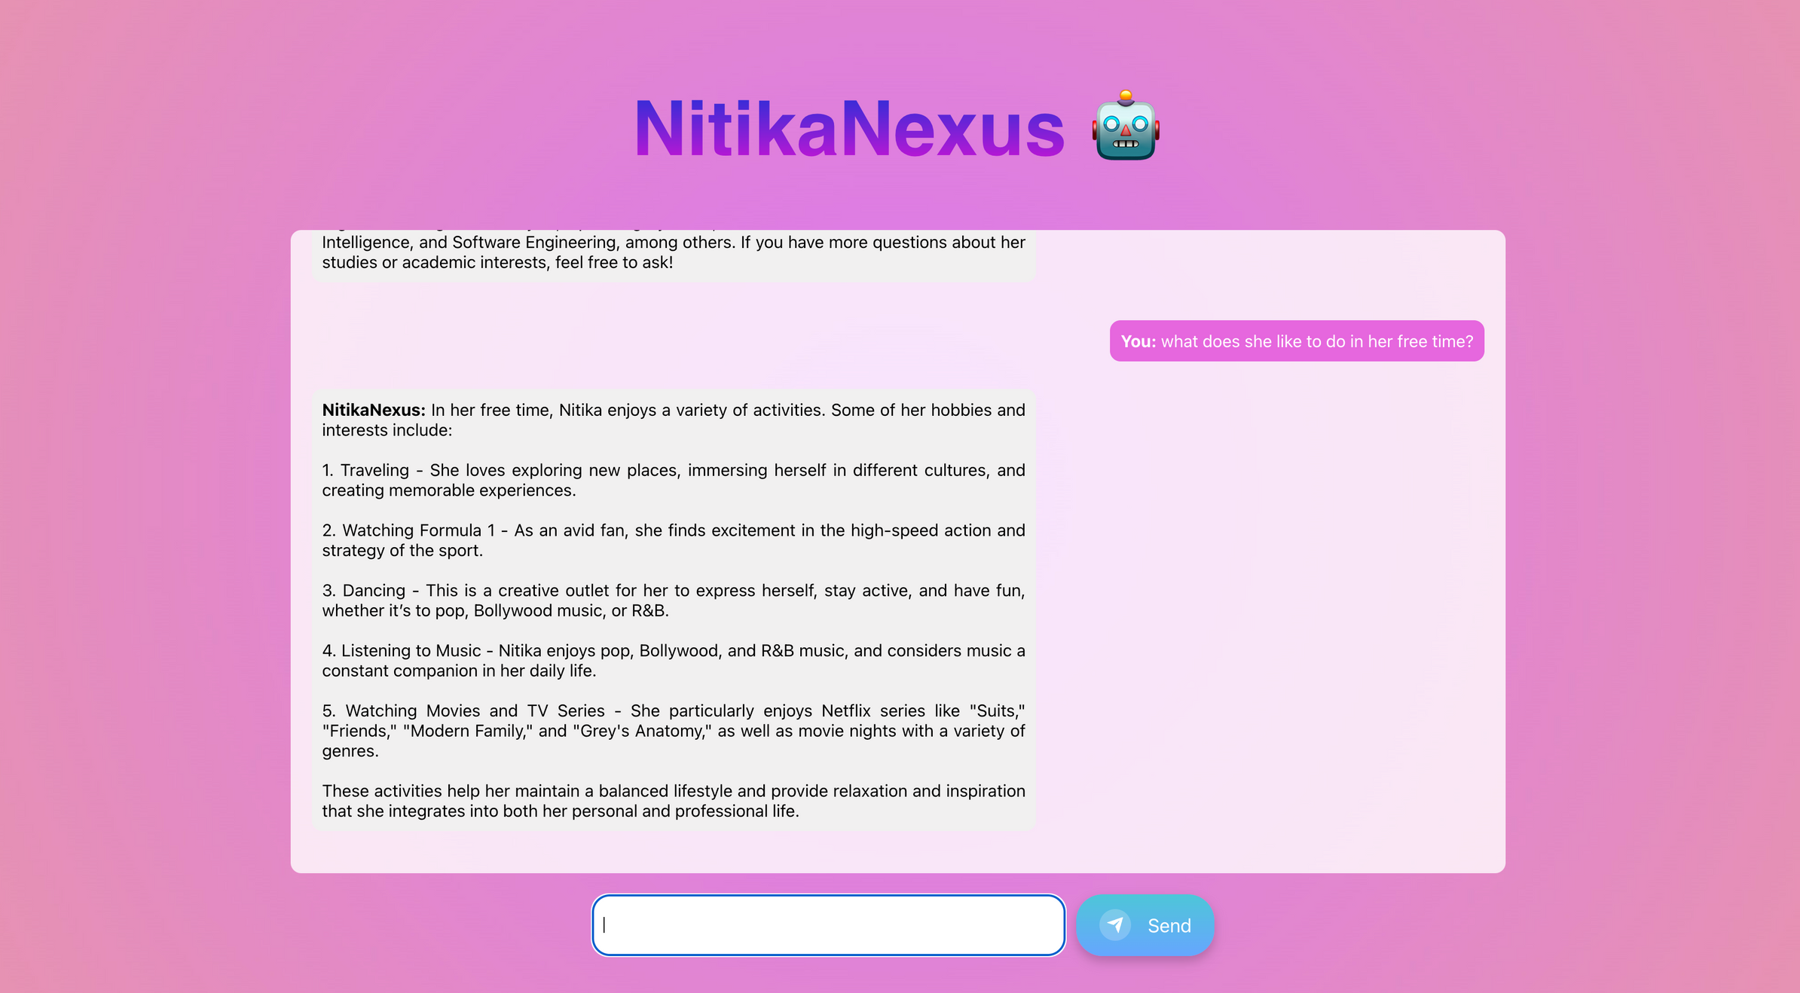

Slide 8
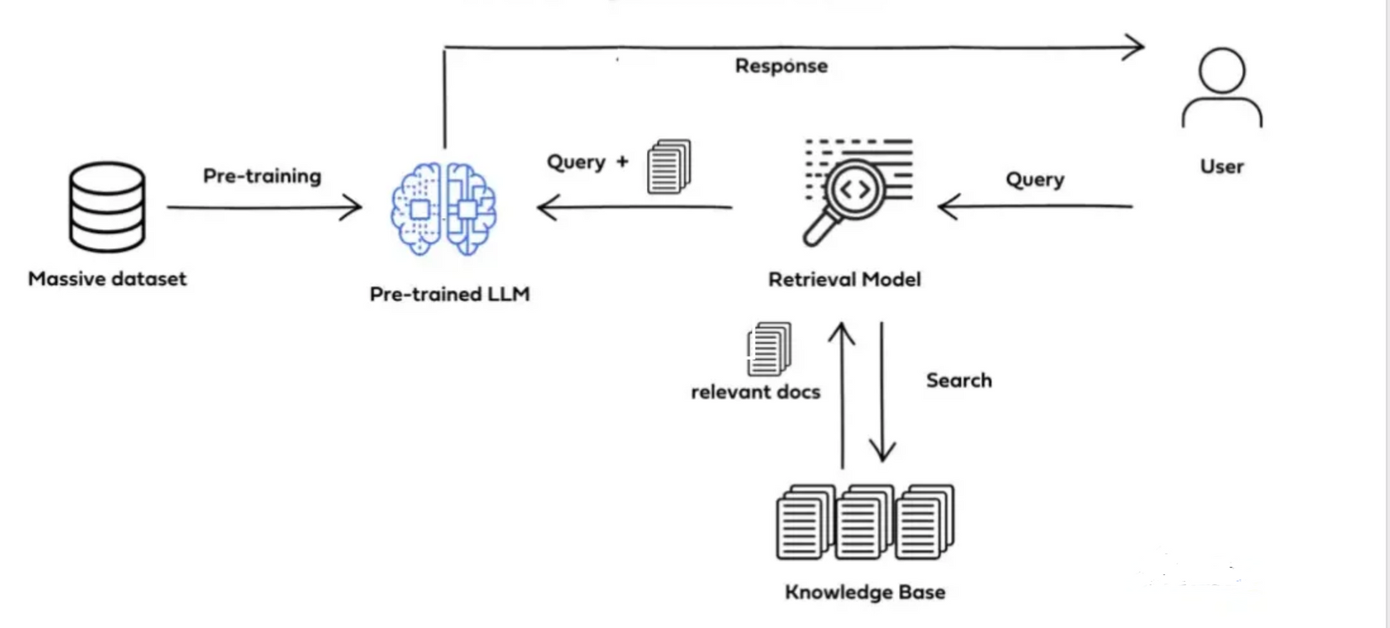
System Architecture

Slide 9
Deployement
1. Backend Deployment (Heroku)
Setup:
Heroku Account & CLI: Created account and installed CLI.
Configuration Files:
Procfile: Defines how to run the application.
requirements.txt: Lists Python dependencies.
Frontend Deployment (Vercel)
Setup:
Vercel Account & Repository: Linked GitHub repo.
Process:
Automatic Deployments: On push to main.
Manual Deployment: Deploy via Vercel dashboard if needed.
Post-Deployment:
Domain Configuration & Environment Variables
Process:
Initialize Git: Ensure project is in Git.
Create & Deploy:
heroku create
git push heroku main
Migrate & Monitor:
heroku run python manage.py migrate
heroku logs --tail
Post-Deployment:
Environment Variables & Add-ons

Slide 10
Thank You

